Slide 1

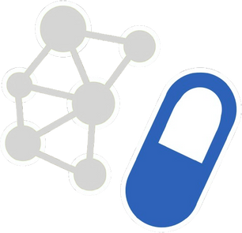
BIO425 - GRADUATION PROJECT IN BIOINFORMATICS (II)
INTERPRETABLE DRUG REPURPOSING PLATFORM BASED ON GRAPH NEURAL NETWORKS
PREPARED BY
SALAH GAMAL, AHMED GABR, AHMED HAMDY, AHMED ALI, SARA AYMAN, ALIAA MOHAMED
SUPERVISED BY
PROF. DR. NOHA ELATTAR

Slide 2
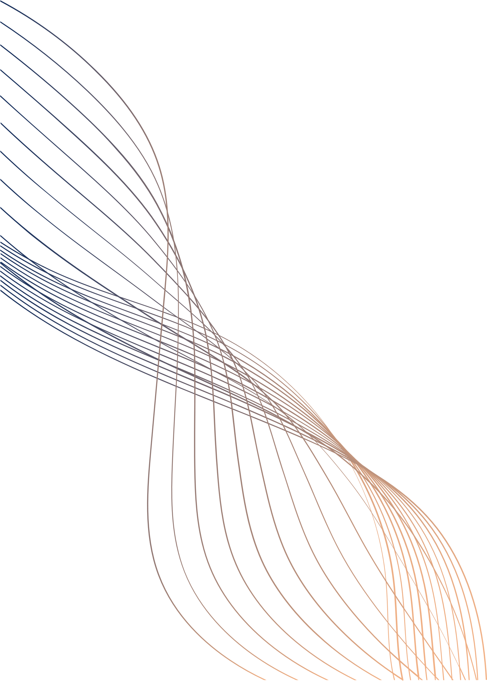
TABLE OF CONTENTS
I
II
INTRODUCTION
METHODOLOGY
III
IV
WEB APPLICATION
RESULTS
V
VI
CASE STUDIES
CONCLUSION

Slide 3
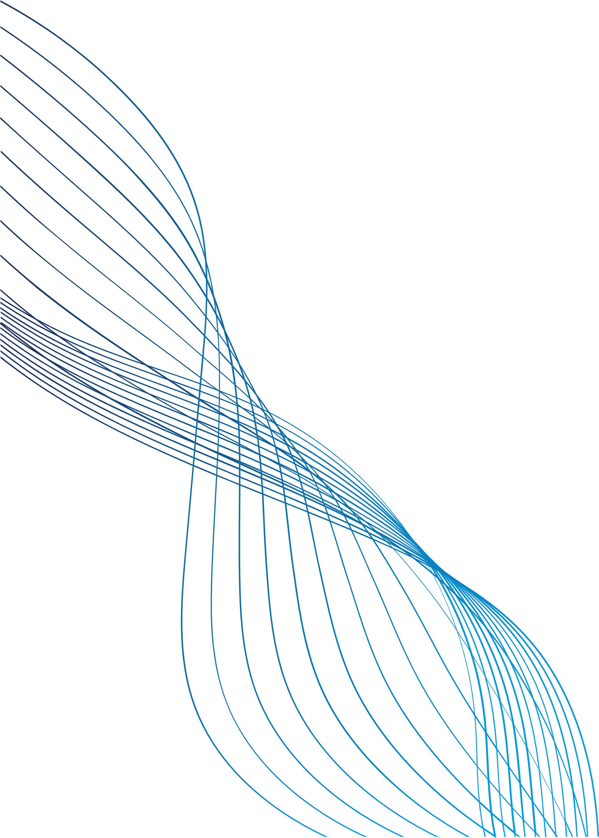
I)
INTRODUCTION
I.I) INTRODUCTION
I.2) MOTIVATION
I.3) PROBLEM STATEMENT
I.4) OBJECTIVE

Slide 4

I.I) INTRODUCTION
Drug Repurposing:
The process of finding new therapeutic uses for existing drugs, beyond their original FDA-approved indications.
Key Benefits:
Accelerates Drug Discovery
Cost-Effective
Addresses Unmet Needs
FDA Approval Trends
Impact:
Offers a faster pathway to clinical application.
Reduces risks and supports precision medicine for neglected and rare diseases.

Slide 5
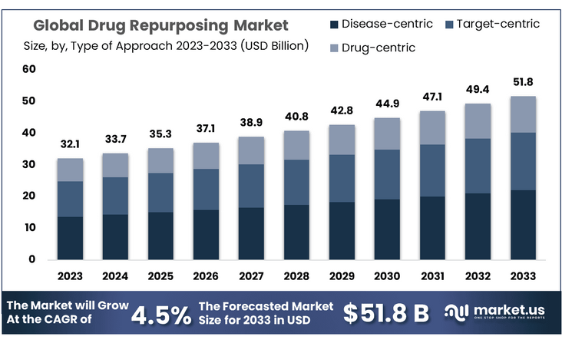
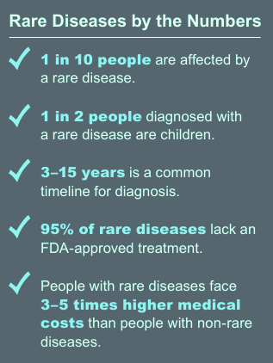
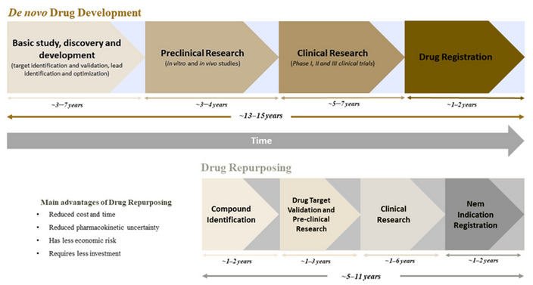
I.2) MOTIVATION

Slide 6
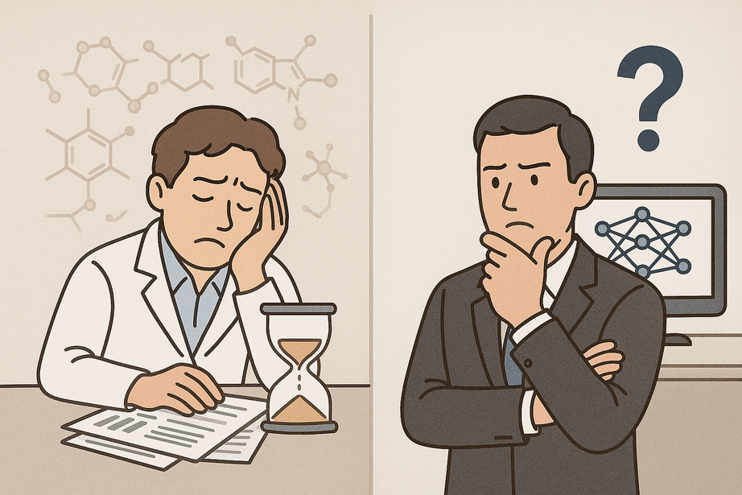
I.3) PROBLEM STATEMENT
TRADITIONAL APPROACHES:
TIME-CONSUMING
LIMITED SCOPE
HIGH COST
BIAS
SCALABILITY ISSUES
EARLIER ML APPROACHES:
MANUAL FEATURE ENGINEERING
STATIC MODELS
LIMITED DATA
BIAS
OVERFITTING
INTERPRETABILITY

Slide 7
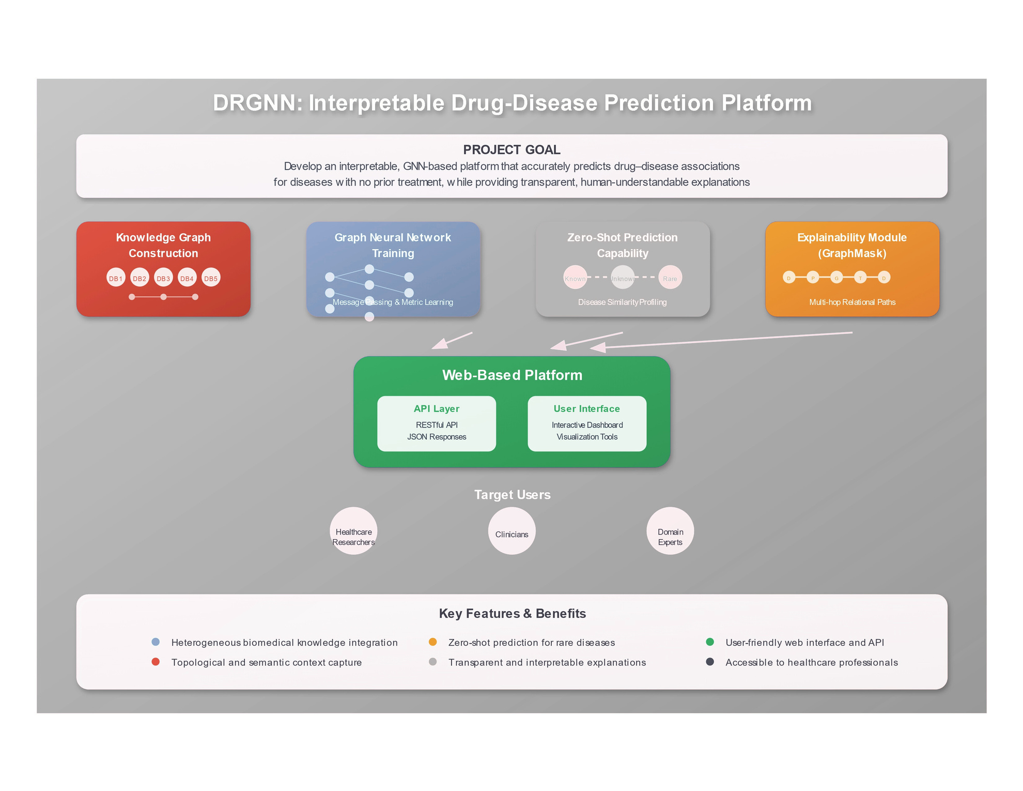
I.4) OBJECTIVE

Slide 8
II)
METHODOLOGY
II.I) DATA LAYER
II.2) PREDICTOR MODULE
II.3) EXPLIANER MODULE
II.4) WEB APPLICATION

Slide 9
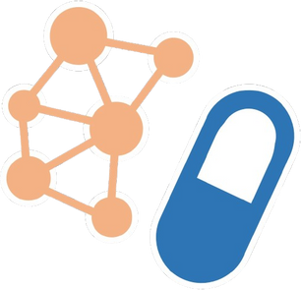
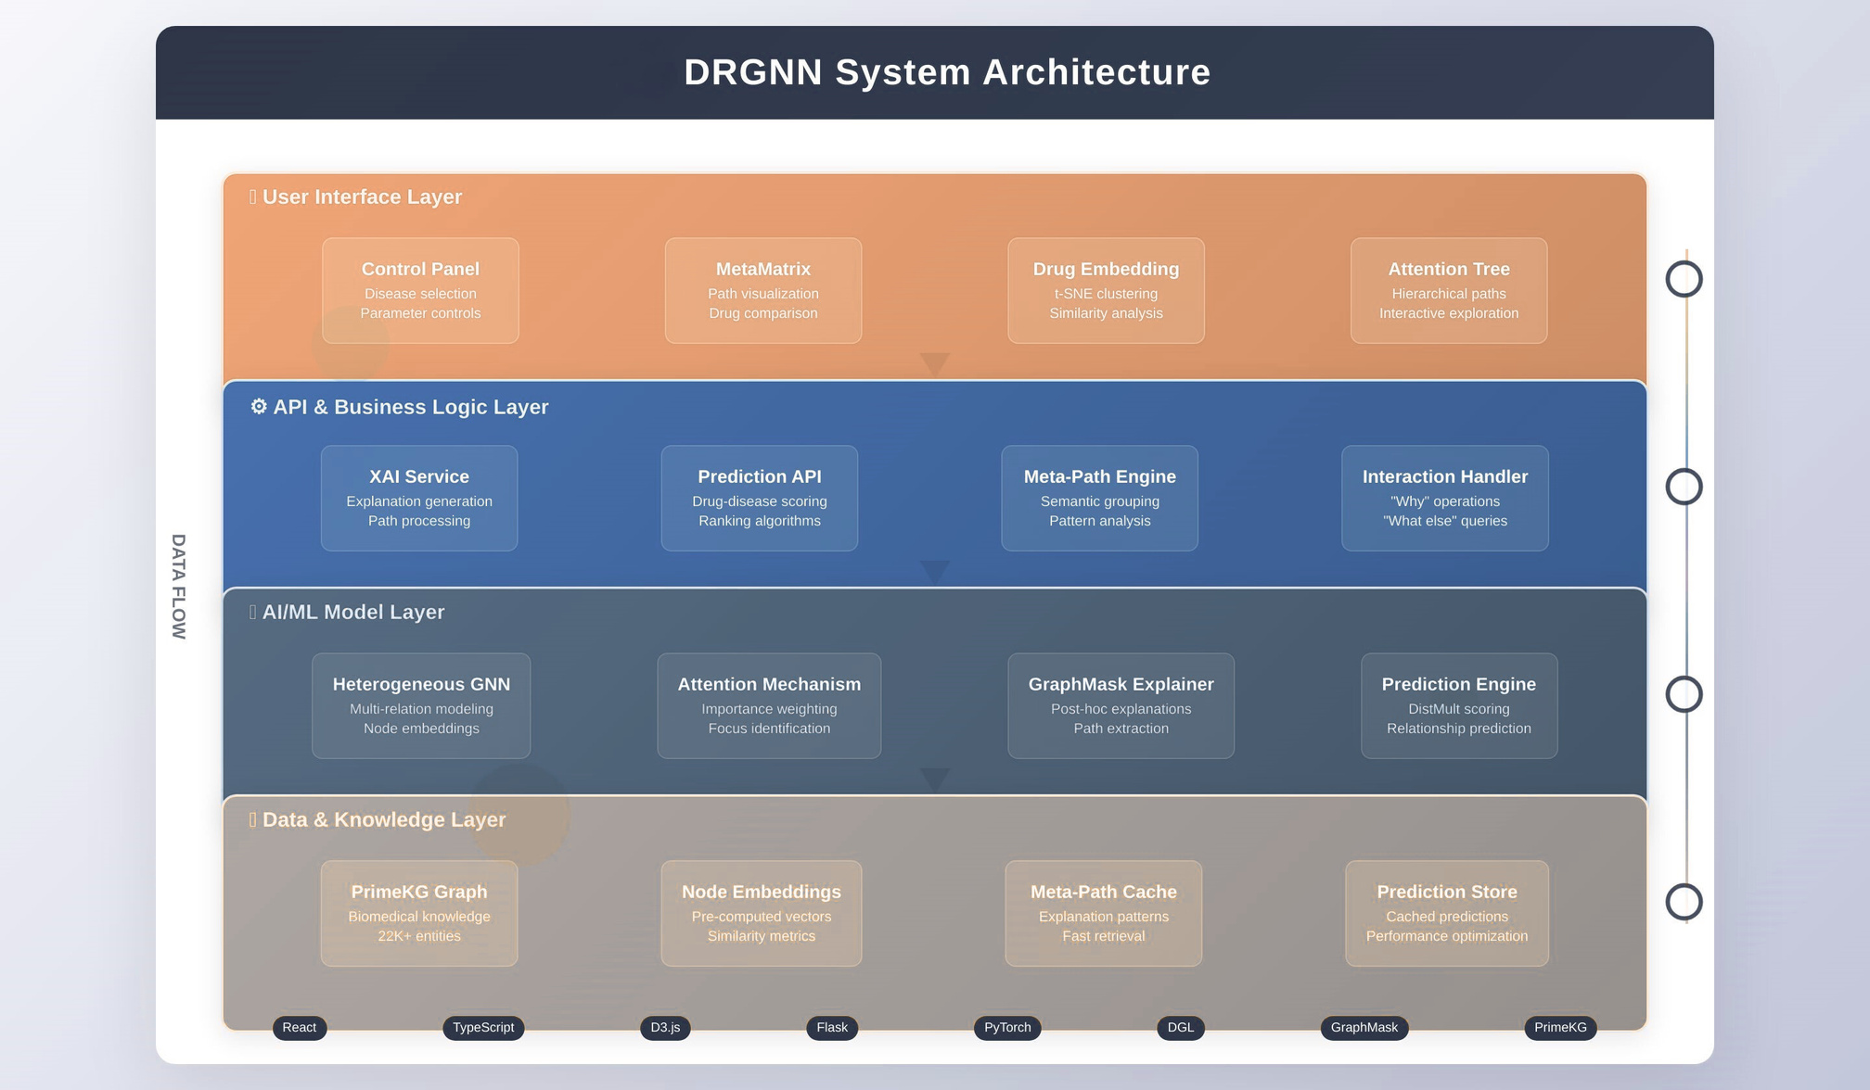

Slide 10
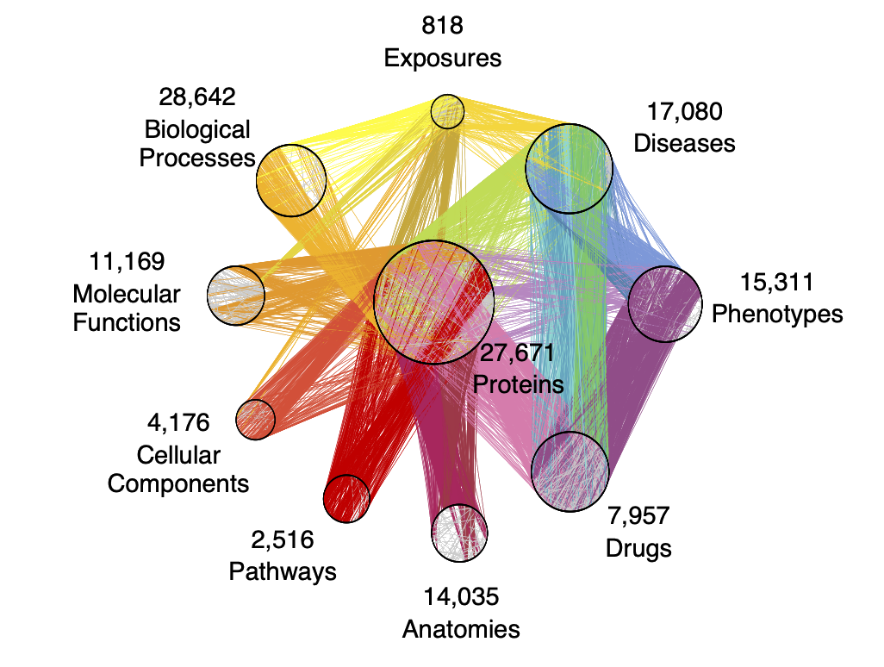

II.1) Data layer
harvard dataverse

Slide 11
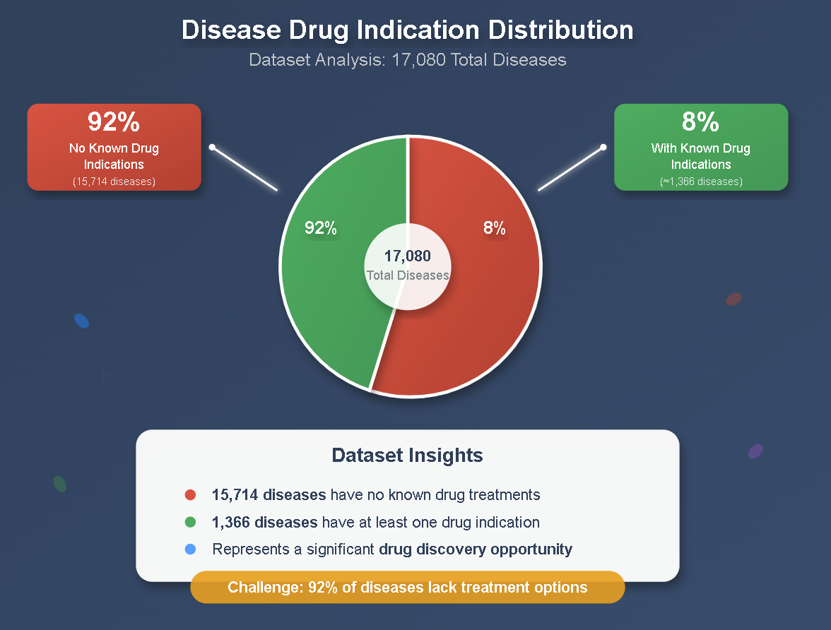

Slide 12
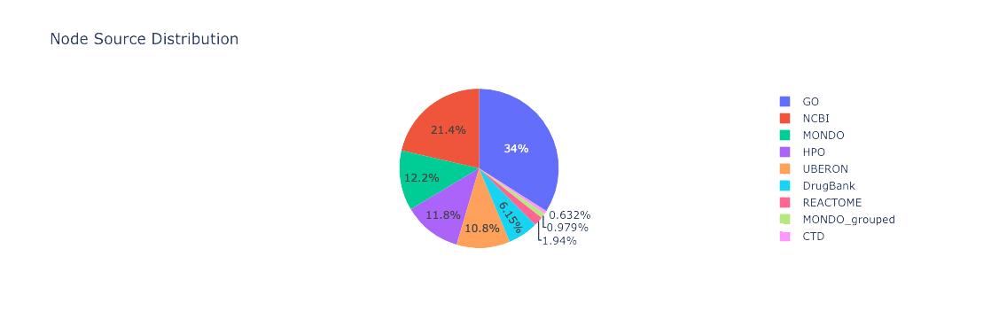
Data soures

Slide 13
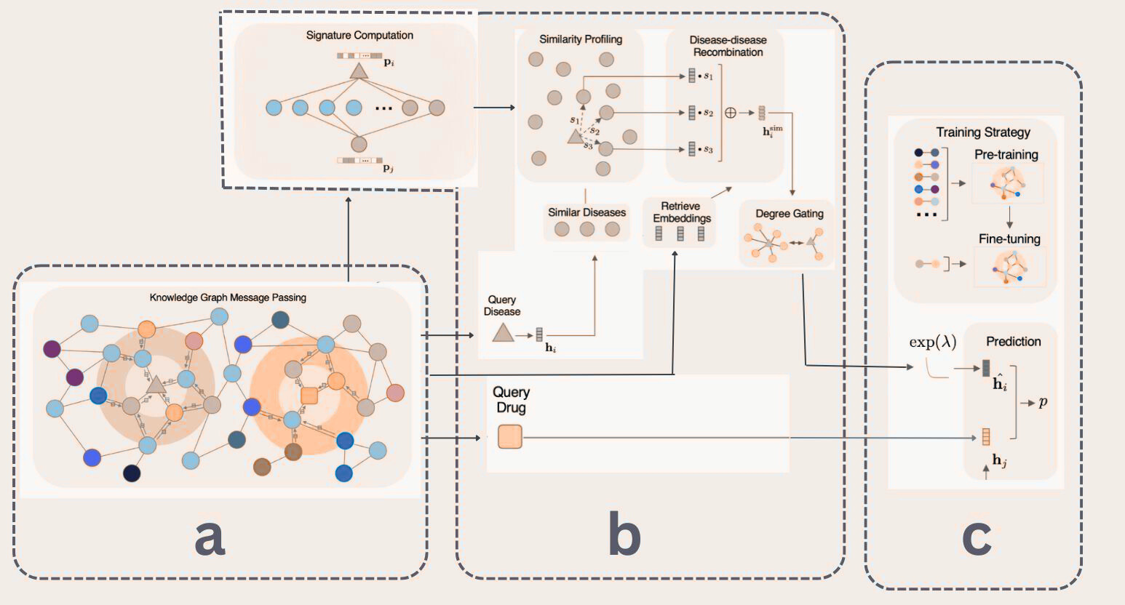
II.2) MODEL PIPELINES

Slide 14
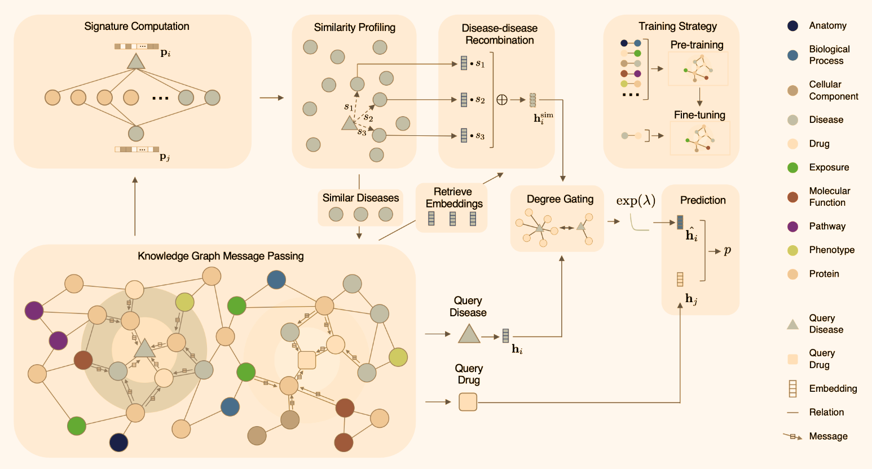
a) Knowledge Graph Message Passing

Slide 15
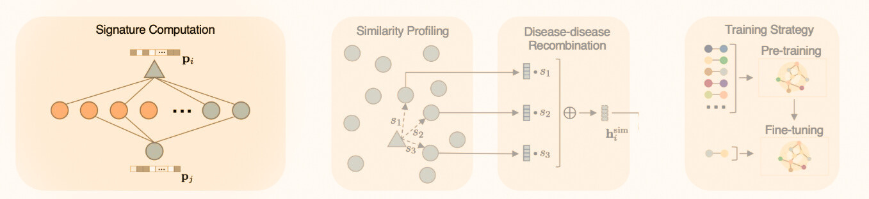
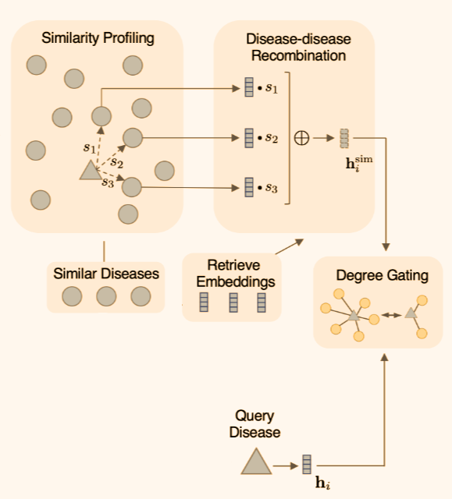
b) Similarity Profiling and Disease Embedding Enhancement

Slide 16
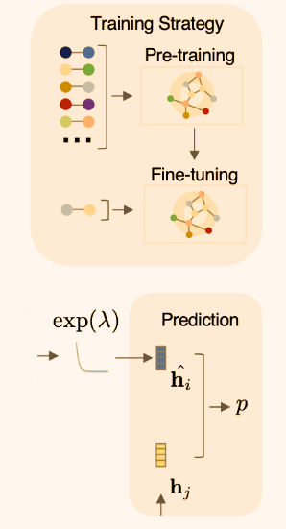
C) Training and Prediction

Slide 17
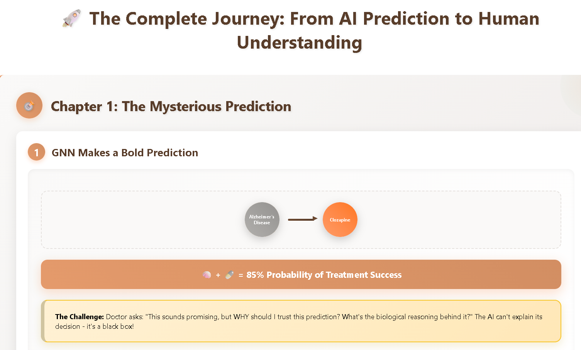
II.3) EXPLIANER MODULE

Slide 18
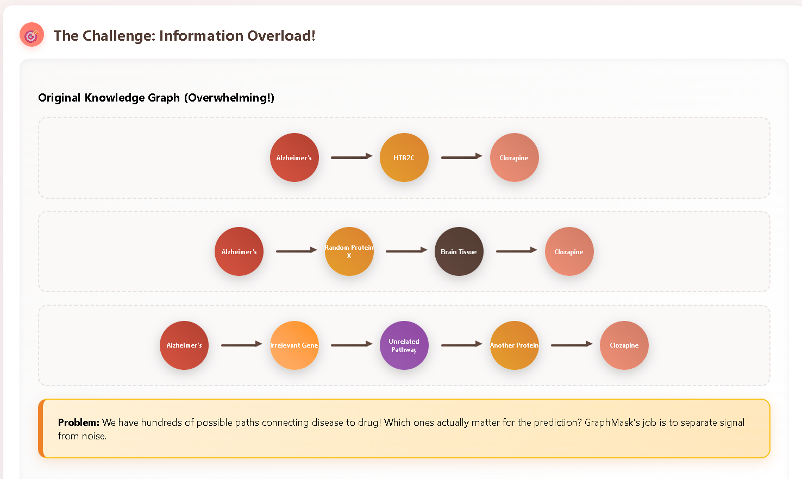

Slide 19
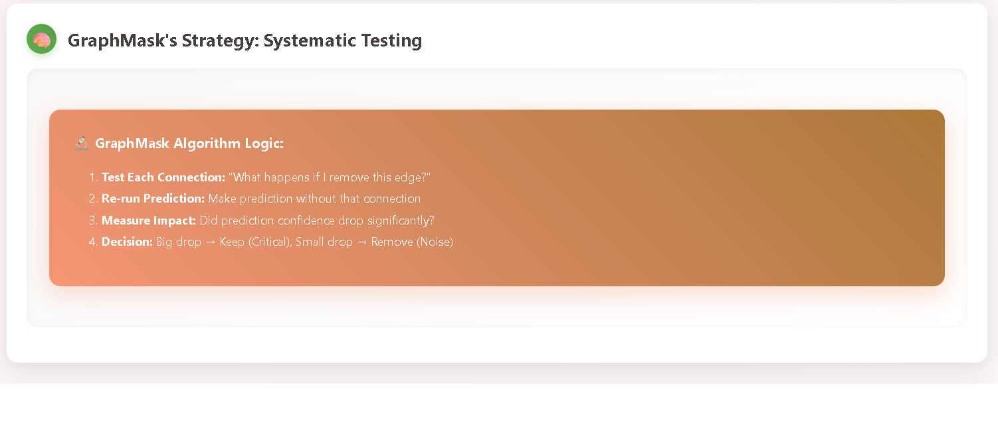

Slide 20
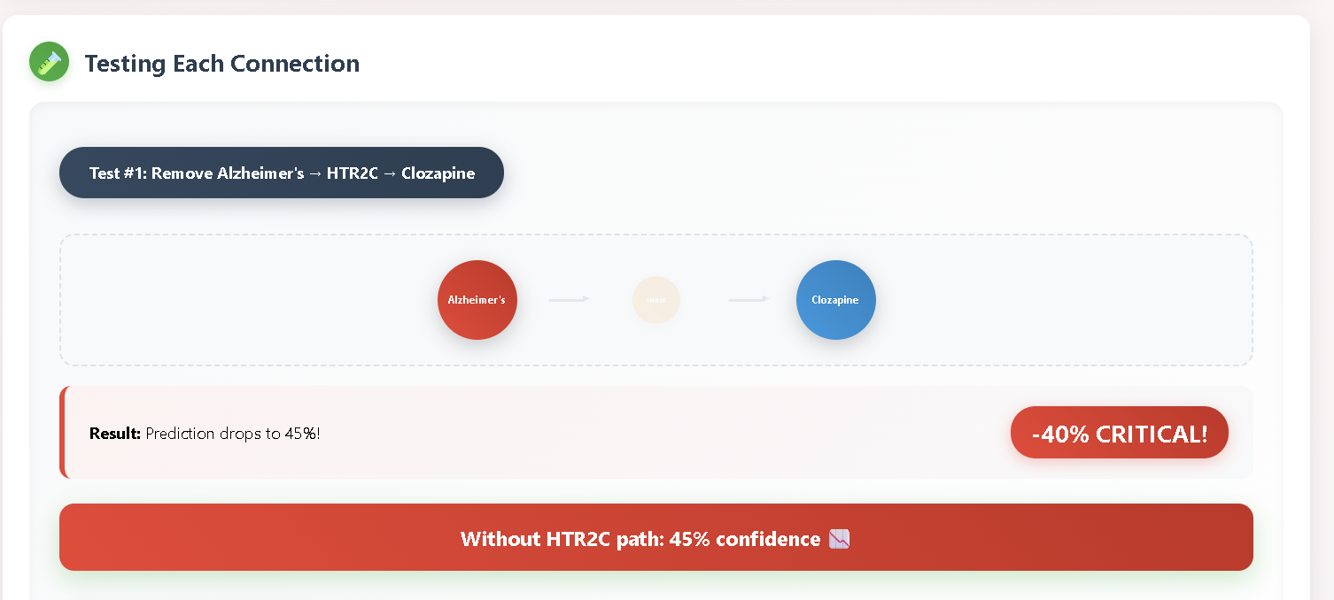

Slide 21
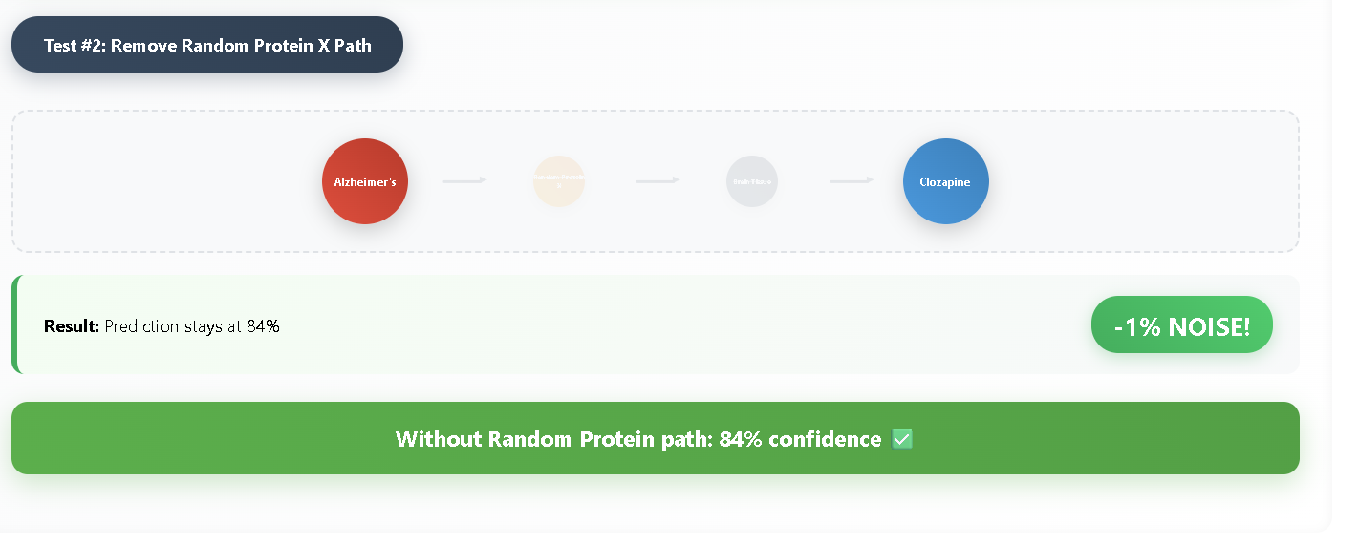

Slide 22
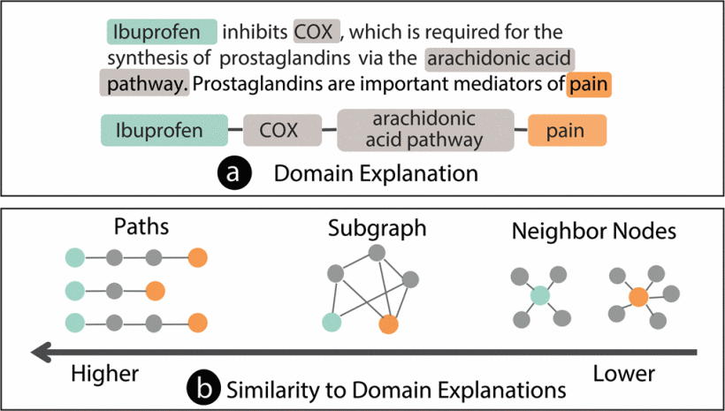

Slide 23
III)
WEB APPLICATION
III.I) PROPOSEDUS USER INTERFACE
II.2) APPLICATION ARCHITECTURE
II.3) FINAL PRODUCT

Slide 24
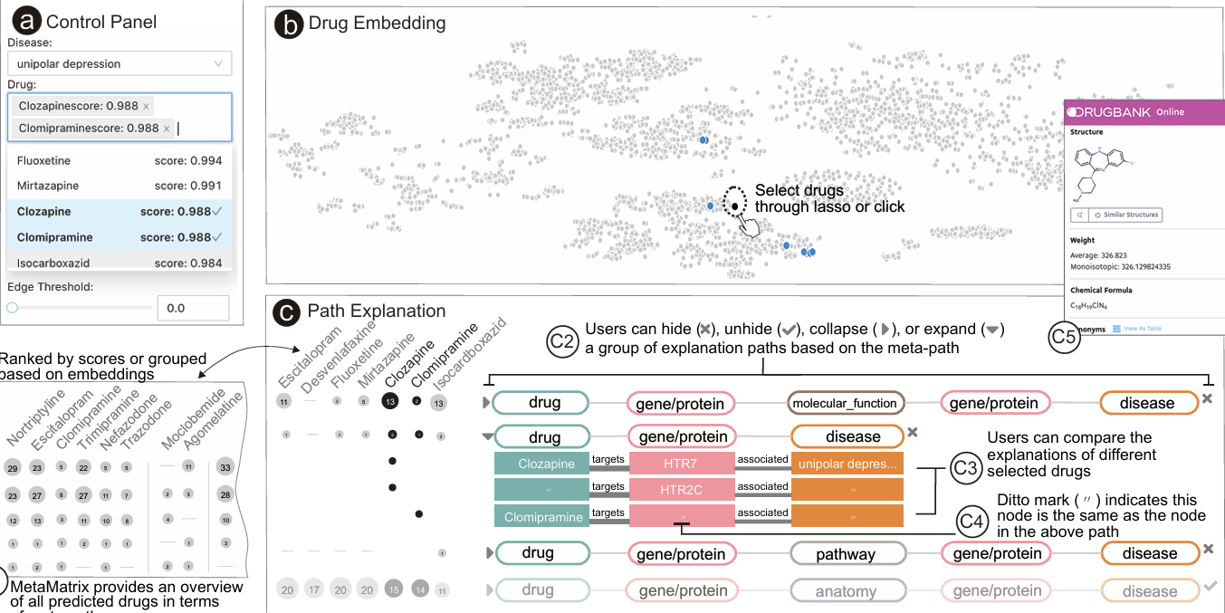
III.I) PROPOSEDUS USER INTERFACE

Slide 25
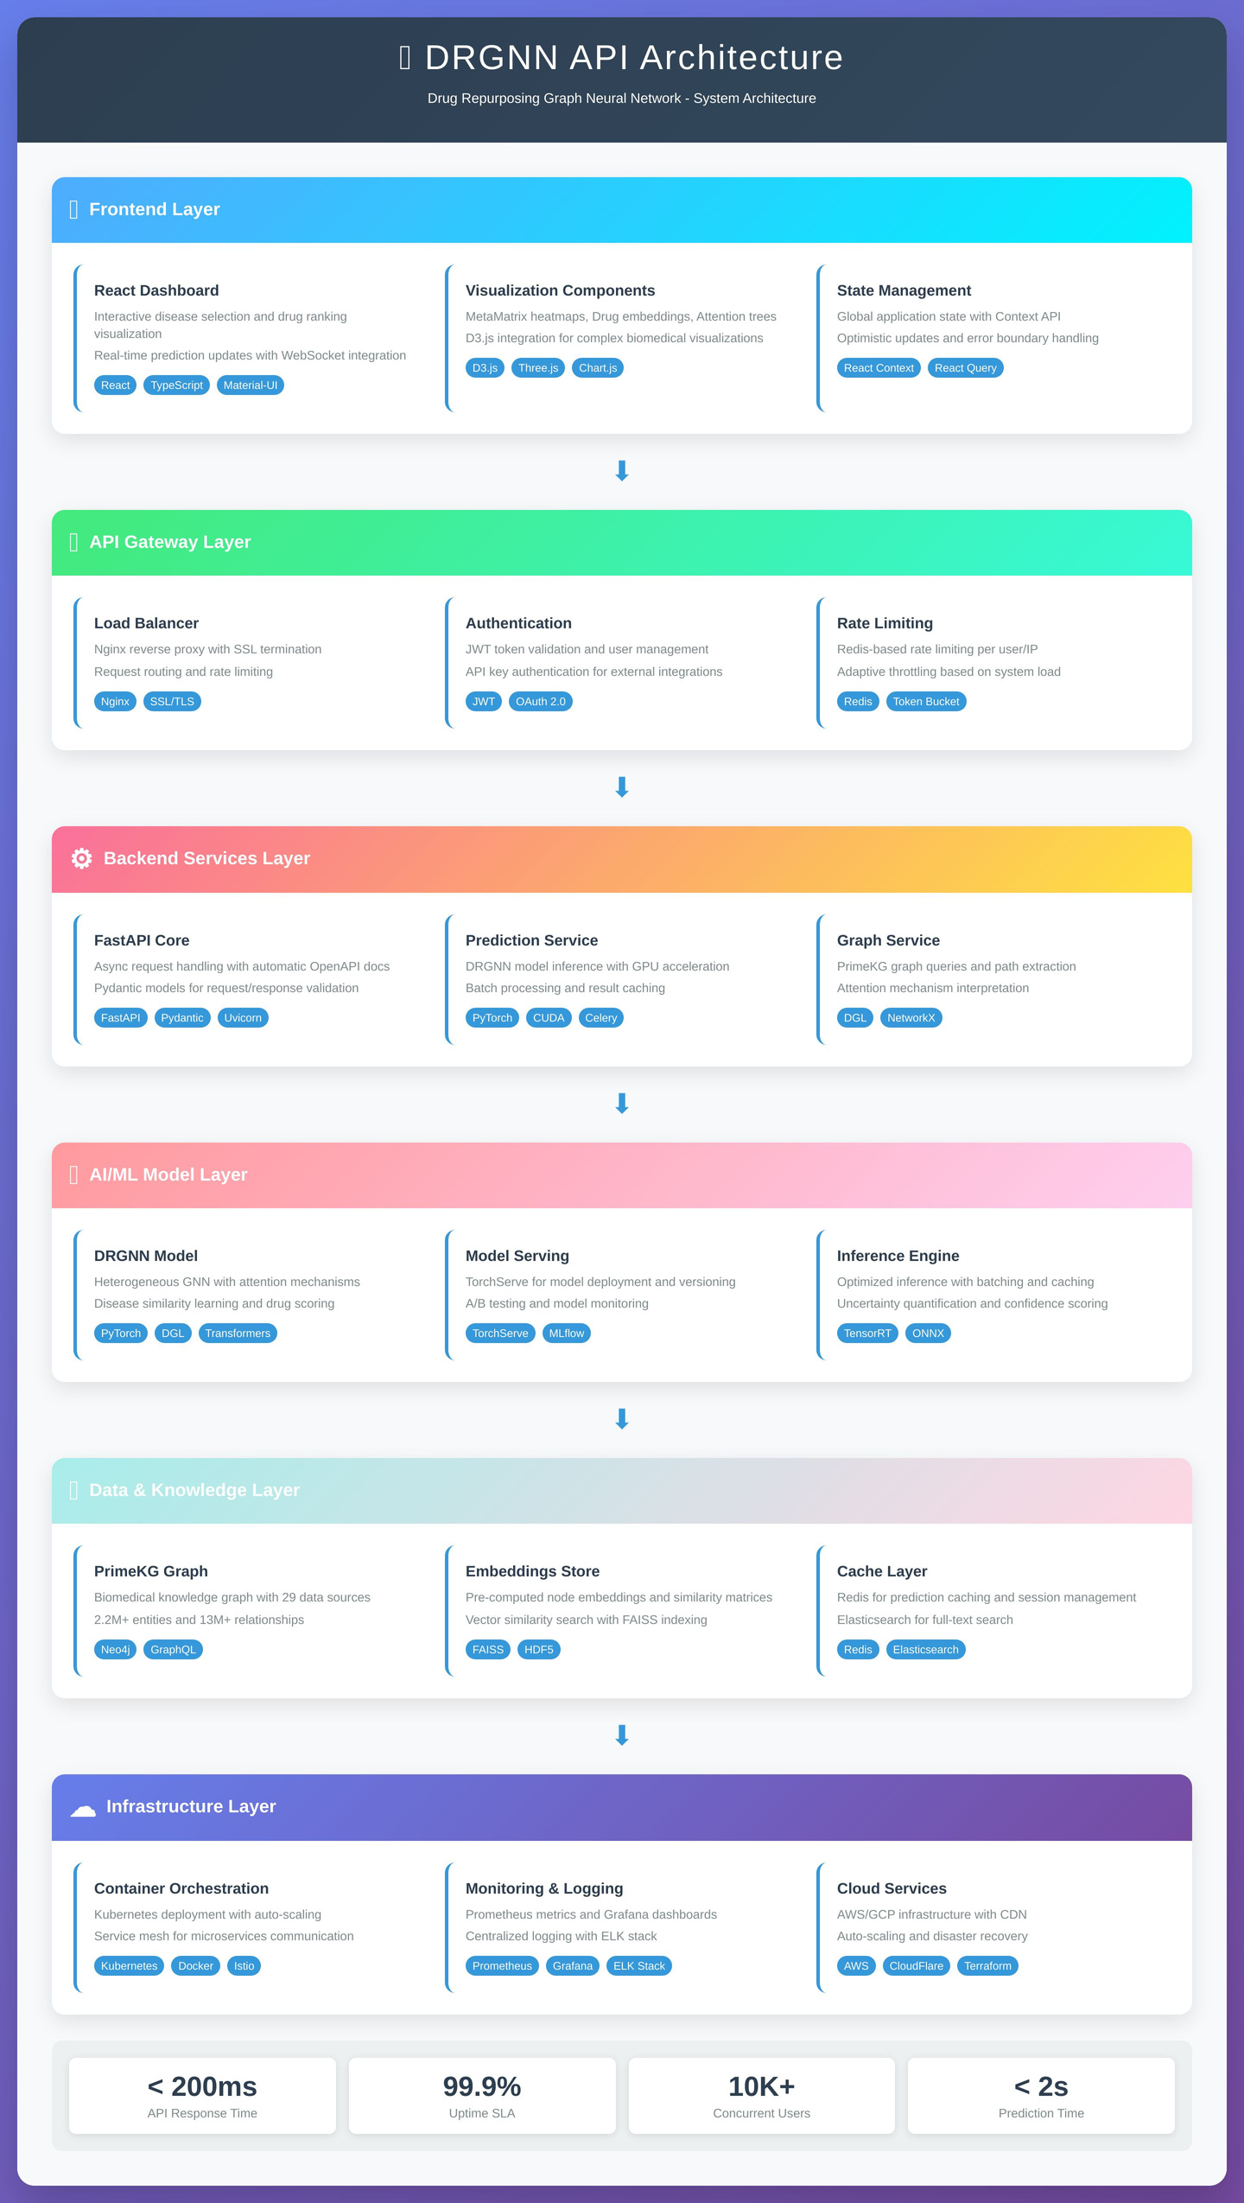
II.2) APPLICATION ARCHITECTURE

Slide 26
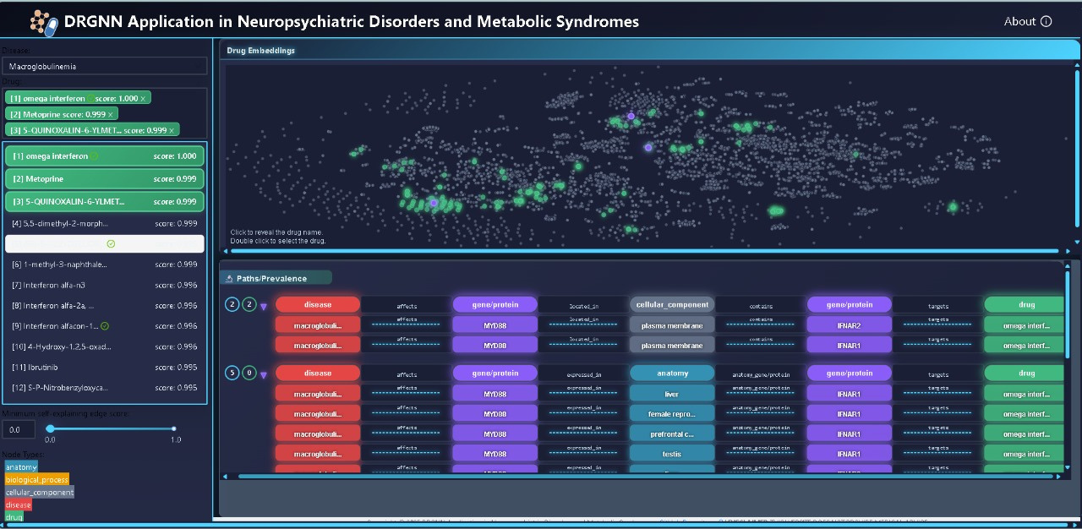
II.3) FINAL PRODUCT

Slide 27
IV)
RESULTS
IV.I) MAIN LEARNING PROGRESS
IV.2) EVALUATION CONSIDERATIONS
IV.3) COMPREHENSIVE BENCHMARKING TO OUR METRICS

Slide 28
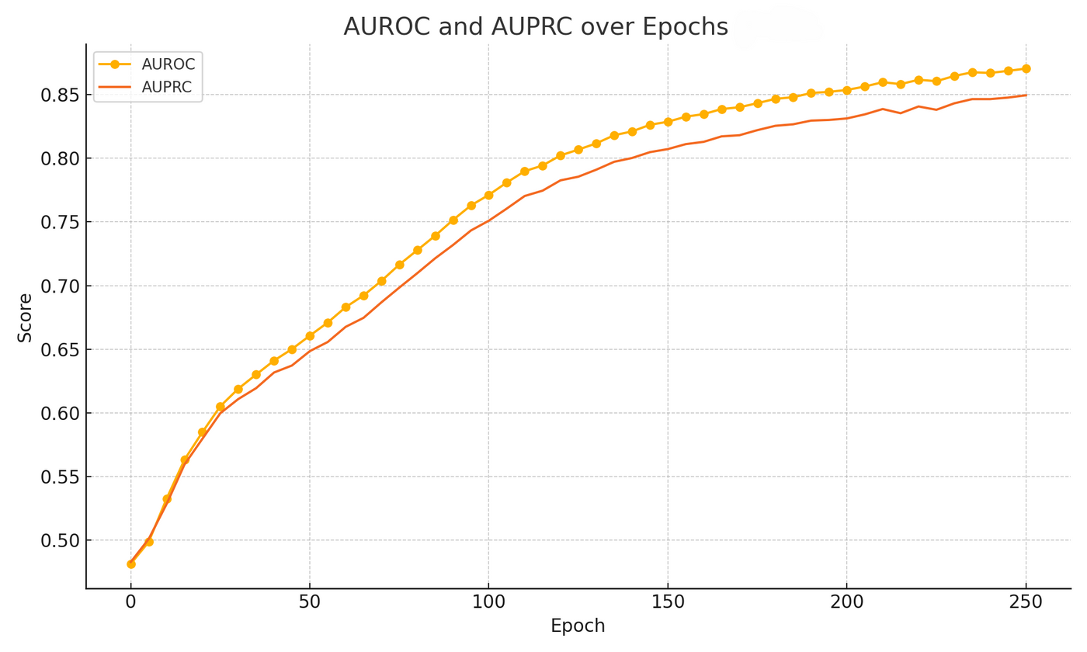
PERFORMANCE AFTER FINE-TUNING
FOR SPECIFIC RELATIOMS
0.8744
0.8496
AUROC
AUPRC

Slide 29
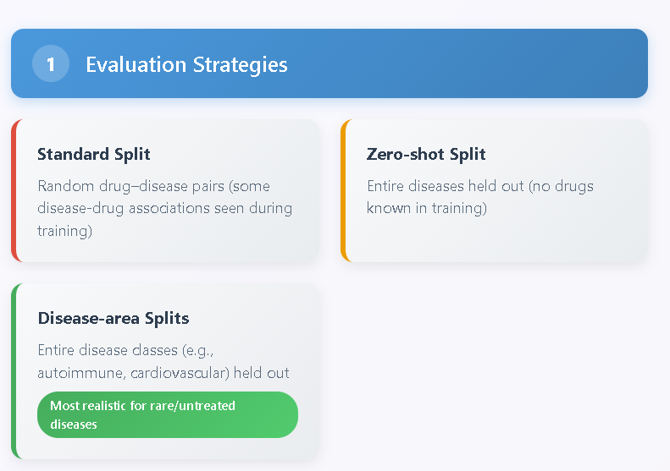
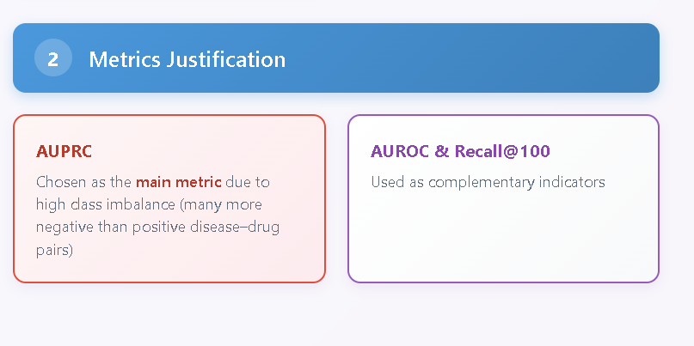

EVALUATION CONSIDERATIONS

Slide 30
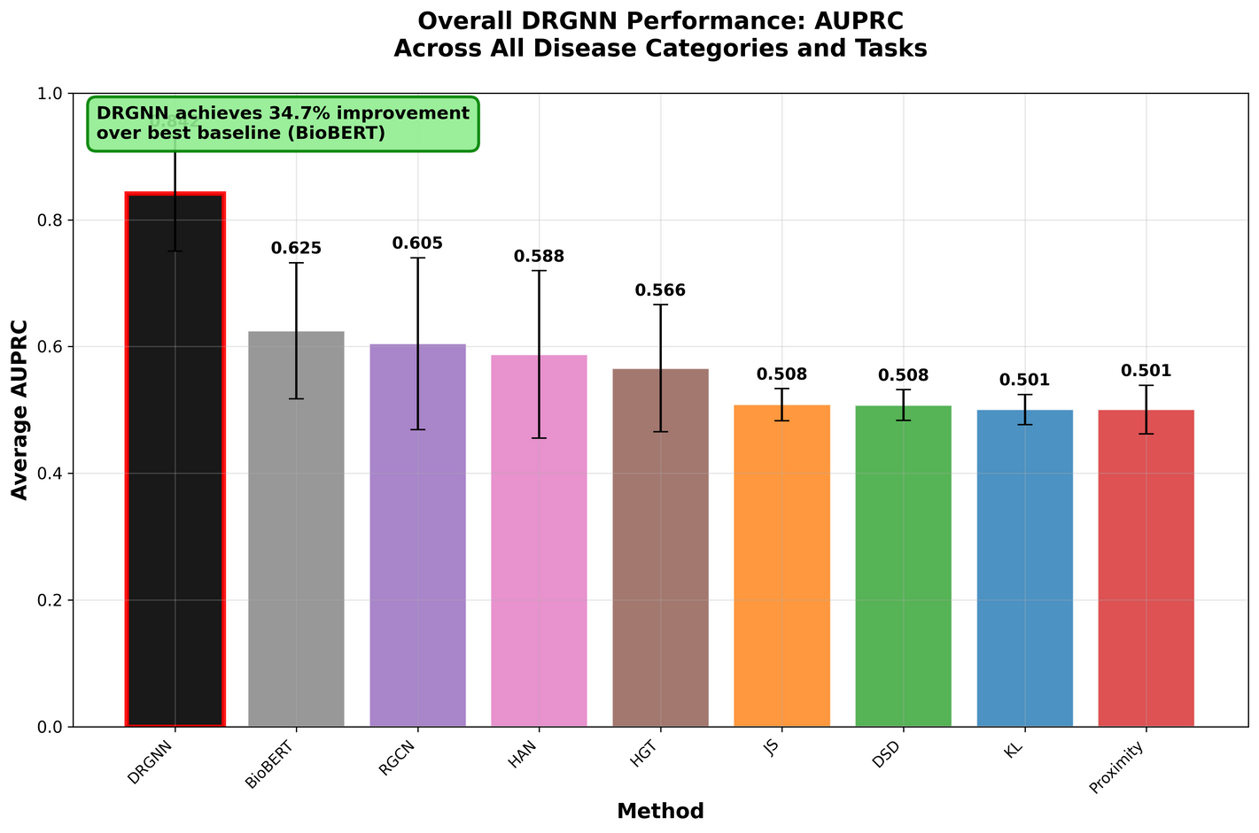
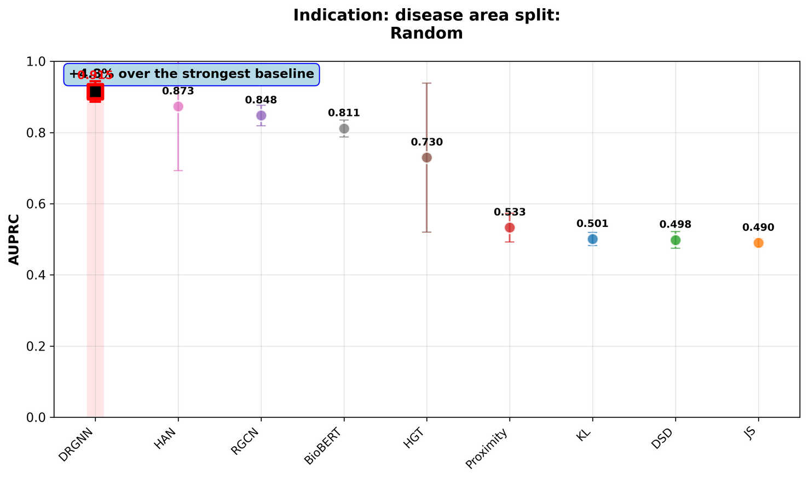
BENCHMARKING USING AUPRC

Slide 31
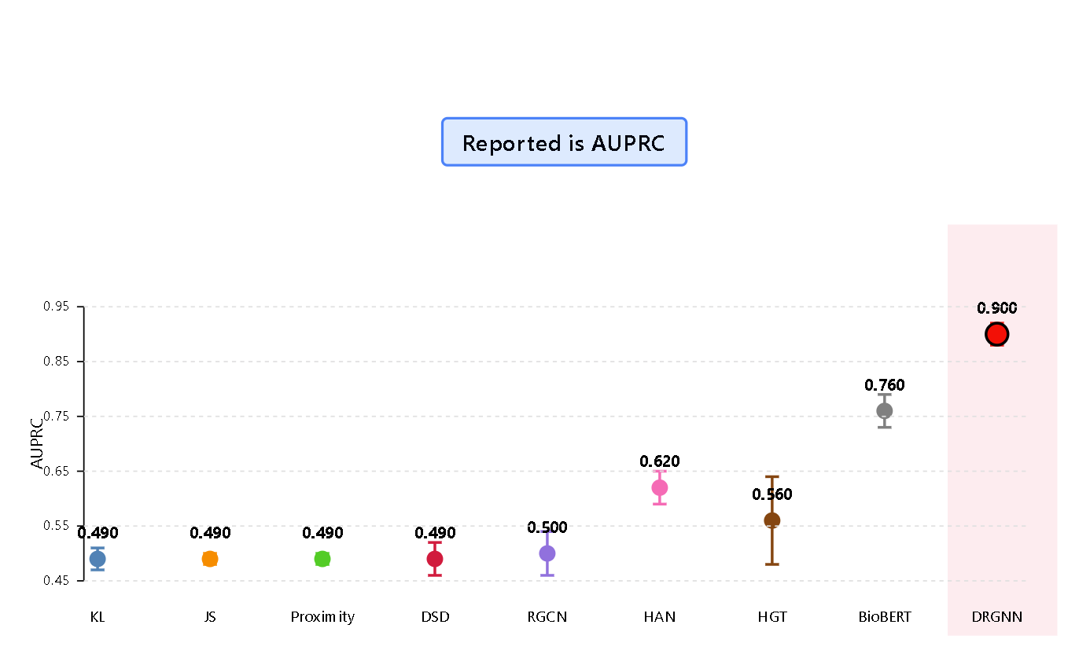
BENCHMARKING USING AUPRC
FOR ZERO-SHOT PREDICTION

Slide 32
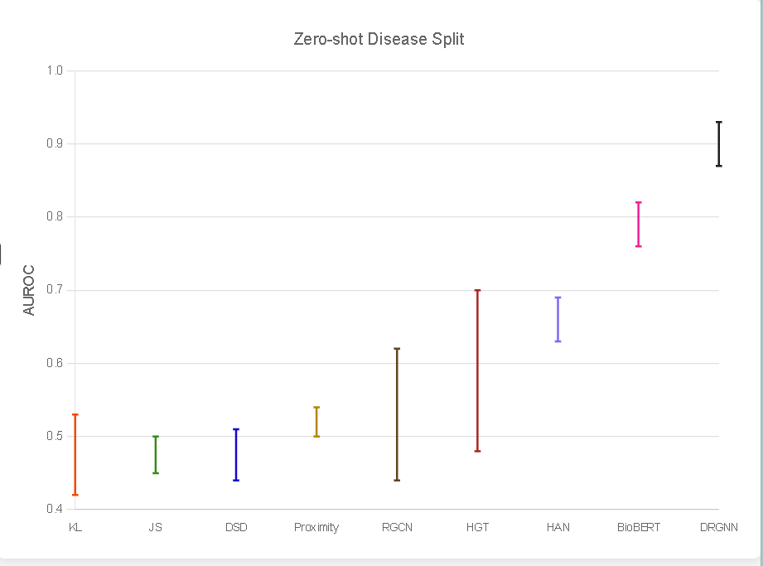
BENCHMARKING USING AUROC
FOR ZERO-SHOT PREDICTION

Slide 33
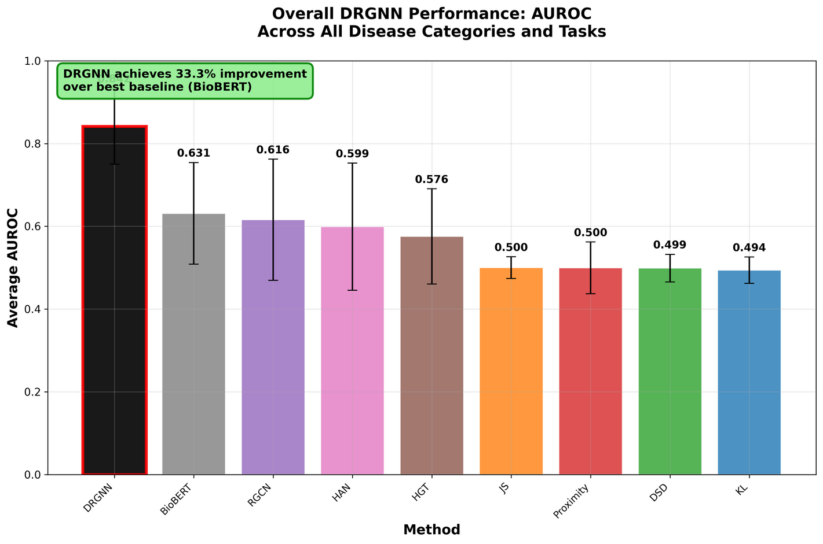
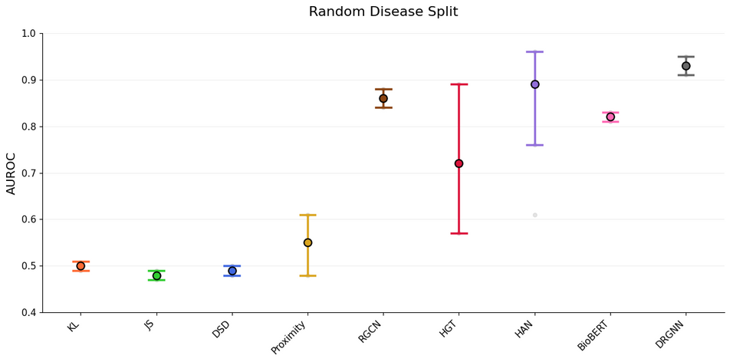
BENCHMARKING USING AUROC
RANDOM, AVERAGE DISEAS

Slide 34
V
CASE STUDIES FROM OUR PLATFORM

Slide 35
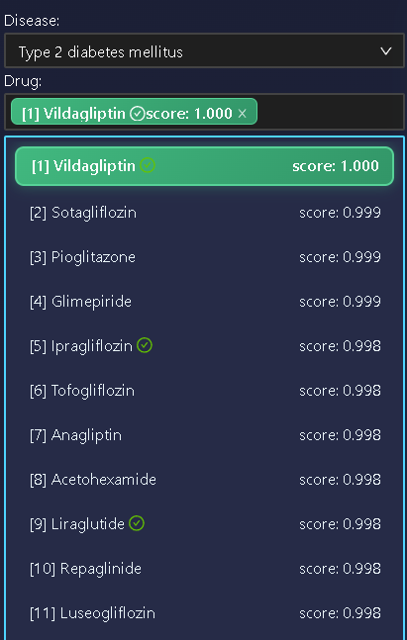
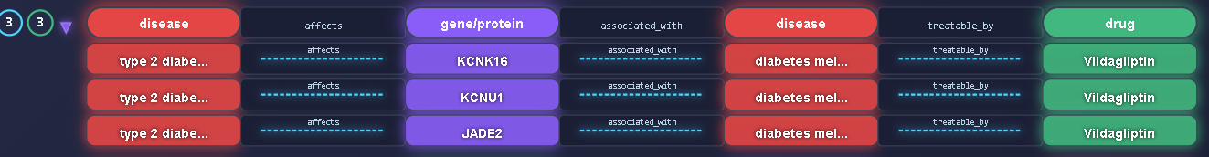
INTERPRETABLE LINK BETWEEN TYPE 2 DIABETES MELLITUS, ANDVILDAGLIPTIN
TYPE 2 DIABETES MELLITUS (T2DM) IS A COMPLEX METABOLIC DISORDER CHARACTERIZED BY CHRONIC HYPERGLYCEMIA, INSULIN RESISTANCE, AND PROGRESSIVE PANCREATIC BETA-CELL DYSFUNCTION. MULTIPLE GENETIC AND MOLECULAR FACTORS CONTRIBUTE TO DISEASE ONSET AND PROGRESSION.
THE DRGNN MODEL PREDICTS VILDAGLIPTIN AS A TOP-RANKED CANDIDATE FOR T2DM TREATMENT (SCORE: 1.000), AND PROVIDES AN INTERPRETABLE MULTI-HOP REASONING PATH THAT SUPPORTS THIS PREDICTION BIOLOGIC

Slide 36
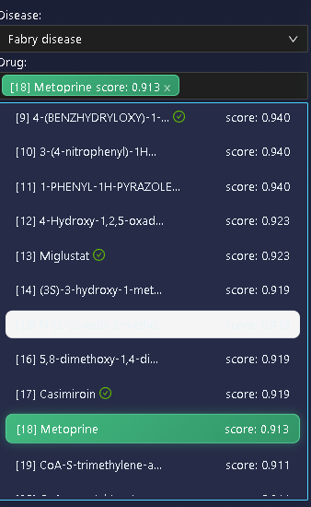
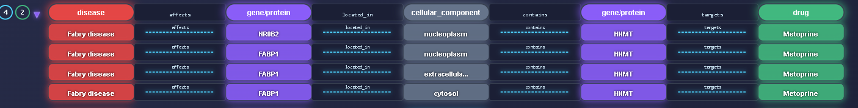
INTERPRETABLE LINK BETWEEN FABRY DISEASE AND METOPRINE
DRGNN IDENTIFIES METOPRINE AS A POTENTIAL TREATMENT FOR FABRY DISEASE WITH A STRONG PREDICTION SCORE (0.913). THE INTERPRETABILITY PATH REVEALS:
FABRY DISEASE AFFECTS GENES LIKE FABP1 AND NR0B2, WHICH ARE LOCATED IN REGIONS SUCH AS THE NUCLEOPLASM AND CYTOSOL.
THESE REGIONS CONTAIN THE GENE HNMT (HISTAMINE N-METHYLTRANSFERASE), WHICH IS THE TARGET OF METOPRINE.
HNMT IS INVOLVED IN REGULATING HISTAMINE, INFLAMMATION, AND OXIDATIVE STRESS — PROCESSES KNOWN TO WORSEN FABRY SYMPTOMS.
THEREFORE, METOPRINE MAY HELP MANAGE FABRY DISEASE BY MODULATING HNMT ACTIVITY, POTENTIALLY REDUCING INFLAMMATION AND TISSUE DAMAGE.

Slide 37
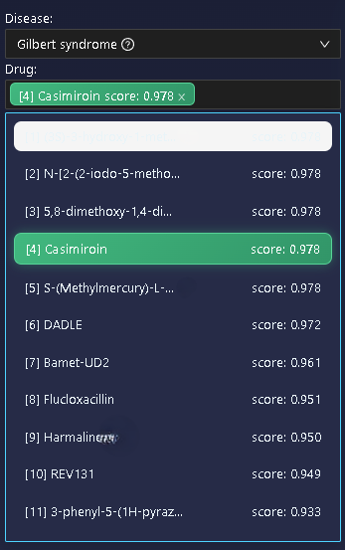
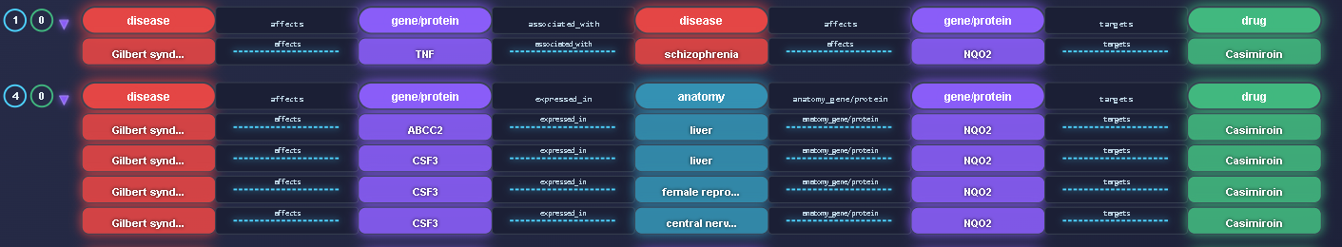
ZERO-SHOT PREDICTION — CASIMIROIN FOR GILBERT SYNDROME
DRGNN IDENTIFIED CASIMIROIN AS A TOP CANDIDATE DRUG (SCORE: 0.978) FOR GILBERT SYNDROME, A RARE LIVER DISORDER WITH NO KNOWN TREATMENT.
ZERO-SHOT PREDICTION: THE MODEL MADE THIS SUGGESTION WITHOUT PRIOR TRAINING EXAMPLES FOR THE DISEASE.
BIOLOGICAL PATH: THE DISEASE AFFECTS GENES LIKE TNF, ABCC2, AND CSF3, WHICH ARE EXPRESSED IN THE LIVER AND LINKED TO OXIDATIVE STRESS.
MECHANISM: THESE GENES CONVERGE ON HQO2, WHICH IS TARGETED BY CASIMIROIN, SUGGESTING POTENTIAL FOR RESTORING REDOX BALANCE.

Slide 38
VI)
CONCLUSION

Slide 39
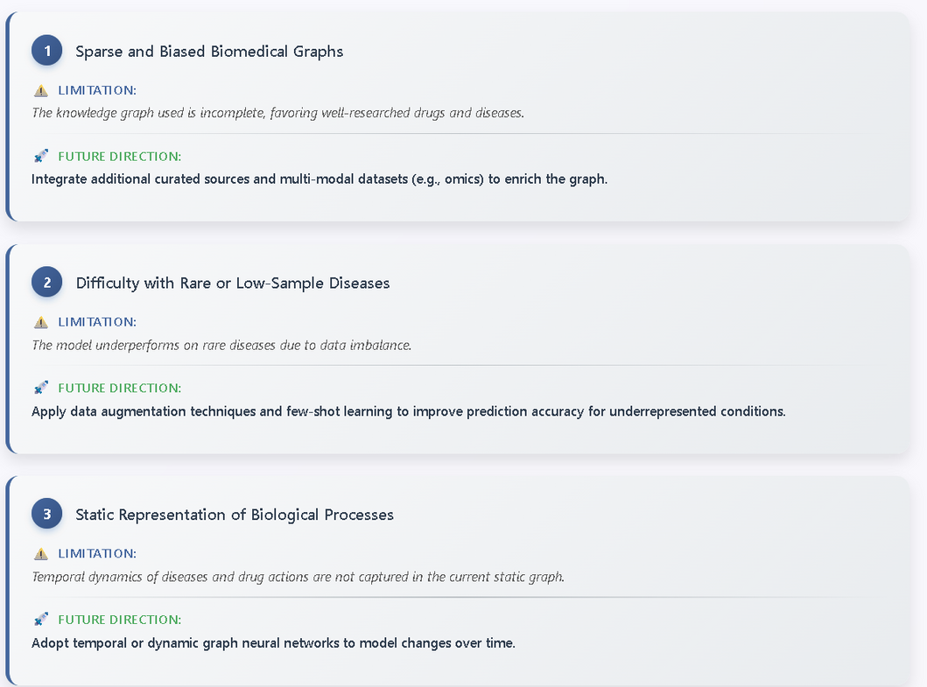
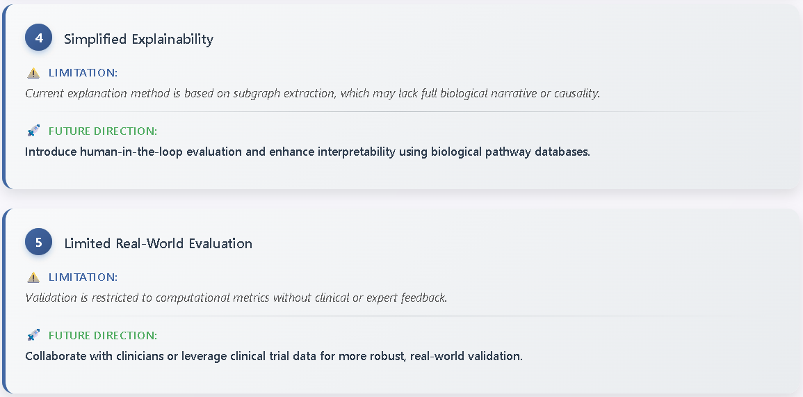
LIMITATIONS & OPPORTUNITIES FOR FUTURE WORK

Slide 40

THANK YOU AND GOODBYE!

